Slide 1
The Simplest Math problem no one can solve !

Slide 2
The Collatz Conjecture

Slide 3
Also called the 3n + 1 problem

Slide 4
Named after Lothar Collatz https://en.wikipedia.org/wiki/Lothar_Collatz

Slide 5
Proposed back in 1937

Slide 6
Unsolved for over 80 years.

Slide 7
Although mathematicians are closer than ever to solve it.
Maybe they will solve it in our lifetimes :)

Slide 8
The Collatz Conjecture also has a bunch of other names:
- Wondrous numbers
- 3n + 1 Conjecture
- Ulam Conjecture
- And many more ...

Slide 9
What is it ?
GIVEN: Any randomly selected positive integer number.
WHEN: Repeating two simple arithmetic operations - in sequence...
THEN: Will eventually transform every positive integer into 1.

Slide 10
Steps
- Each term is based on previous term:
- IF previous term is EVEN -> next term is HALF PREVIOUS TERM
- IF previous term is ODD -> next term is 3 TIMES PREVIOUS TERM PLUS 1

Slide 11
Examples If we start:
With 6 we get: 6, 3, 10, 5, 16, 8, 4, 2, 1 -> Counter/Steps = 9
With 9 we get: 9, 28, 14, 7, 22, 11, 34, 17, 52, 26, 13, 40, 20, 10, 5, 16, 8, 4, 2, 1 -> Counter/Steps = 20
With 16 we get: 16, 8, 4, 2, 1 -> Counter/Steps = 5

Slide 12
THINK != PROOF
Although the conjecture has not been proven, most mathematicians who have looked into the problem ...
They THINK the conjecture is True :) Because experimental evidence and heuristic arguments support it.

Slide 13
Experimental/Computer Evidence
As of 2020, the conjecture has been checked by computers. For all starting values up to 2⁶⁸ ≈ 295 147 905 179 352 825 856.
All initial values tested so far eventually end in the repeating cycle (4; 2; 1) of period 3.

Slide 14
This Computer Evidence
Is not sufficient to prove that the conjecture is true for all starting values.
As in the case of some disproved conjectures, like the Pólya conjecture.
Counterexamples might be found when considering very large/extremely large numbers.

Slide 15
If the conjecture is false:
It can only be because there is a starting number which creates a sequence that doesn't end on 1. It may be a sequence that either:
- Repeats in endless loop - low chance, but still possible - Actually increases - almost zero chance
So far no such Starting Number/Sequence has been found !

Slide 16
Hard to solve
The mathematicians are still working on this problem - to this day. Although many teachers/PhDs in the math circles say:
Don't lose your life/mind with this crazy/pesky math problem :)

Slide 17
Why I chose this math problem for my presentation
First of all - the problem may look simple on the surface. But it seems very hard to actually prove it.
Even in our daily work. Problems can look simple but in reality can be very complex.
Also: Seemingly random sequences are often full of patterns if we look at them in different ways.
Even trying (but not necessarily solving) hard problems can lead to interesting/useful results.

Slide 18
The biggest problem we have in Computer Science
The Halting Problem https://en.wikipedia.org/wiki/Halting_problem
In computability theory, the halting problem is the problem of determining:
GIVEN: We have arbitrary computer program and an input. Whether the program will finish running, or will continue to run forever.
Alan Turing proved in 1936 that a general algorithm to solve the halting problem for all possible program-input pairs cannot exist !

Slide 19
In other words
Rice's theorem https://en.wikipedia.org/wiki/Rice%27s_theorem
In computability theory, Rice's theorem states All non-trivial semantic properties of programs are undecidable.
The Semantic Properties may be - does the program terminate for all possible inputs.

Slide 20
In conclusion
There always will be bugs. This is mathematically proven and 100% unavoidable.
What we can do is minimize the bugs. And control the surface area of the bugs.
But we have to Assume and Live with the fact that: - Bugs - Randomness and - Entropy Are part of the Universe and Life as we know it.

Slide 21
Trivia 1 - Hailstone
The Collatz sequence of numbers involved is sometimes referred to as the hailstone sequence. Or the Hailstone Numbers.
Because the values are usually subject to multiple descents and ascents like hailstones in a cloud. Here are some images to illustrate this.

Slide 22

Trivia 1 - Hailstone - Image 1

Slide 23
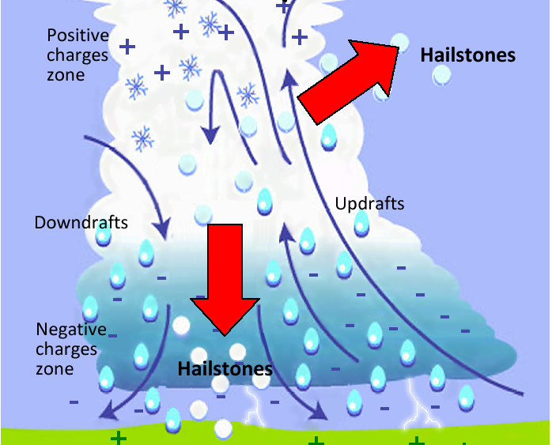
Trivia 1 - Hailstone - Image 2

Slide 24

Trivia 1 - Hailstone - Image 3

Slide 25
Trivia 2 - List of unsolved problems in mathematics
The Holy Grail of the Mathematical Sherlock Holmes problems. Or Mathematical Doctor House problems. :)
Whoever of the 2 geniuses you actually like more :) https://en.wikipedia.org/wiki/List_of_unsolved_problems_in_mathematics

Slide 26
Links 1
The Original Wikipedia page: https://en.wikipedia.org/wiki/Collatz_conjecture
The best YouTube video on the subject: https://www.youtube.com/watch?v=094y1Z2wpJg
The Simplest Math problem no one can solve. Or The Most Dangerous problem in Math.

Slide 27
Links 2
Some Python Implementations:
https://hackernoon.com/implementing-3x1-in-python https://medium.com/@aseemkohli_36958/collatz-conjecture-with-python-834b97171e2a Python Chart/Graph Libraries:
https://www.askpython.com/python/python-plotting-and-graph-libraries https://realpython.com/python-data-visualization-bokeh/ https://wiki.python.org/moin/PythonGraphLibraries

Slide 28
Links 3
Other PP Presentations https://www.slideserve.com/peri/the-collatz-problem
Other Interesting Math Problems / Theorems: https://en.wikipedia.org/wiki/Halting_problem https://en.wikipedia.org/wiki/Rice%27s_theorem https://en.wikipedia.org/wiki/List_of_unsolved_problems_in_mathematics

